Slide 1
MFRE Summer Series: Python Programming 2 Harry Izatt
2023/24 Summer Program

Slide 2
Part 0: Recap
2023/24 Summer Program

Slide 3
Last time:
0. Introduced MFRE Summer Session Data Workshops
1. Data Type Review
2. Lists, Control Flow, Functions Exercises

Slide 4
Last time:
0. Introduced MFRE Summer Session Data Workshops
1. Data Type Review
2. Lists, Control Flow, Functions Exercises

Slide 5
Today: Pandas
Introducing community packages
DataFrames and Series
Functionality, differences
Data Cleaning, Exploration Exercises

Slide 6
Python Workshop 2 Itinerary
1. Pandas Background
1.1 Package Introduction
1.2 DataFrame, Series
2. Pandas Exercises
2.0 Data import
2.1 DataFrame shape
2.2 Column names, data types
2.3 Column summation
2.4 DataFrame indexing
2.5 Slicing and selection
2.6 Boolean Filtering
2.7 Column Operations
2.8 Summary stats
2.9 Capstone Exercise

Slide 7
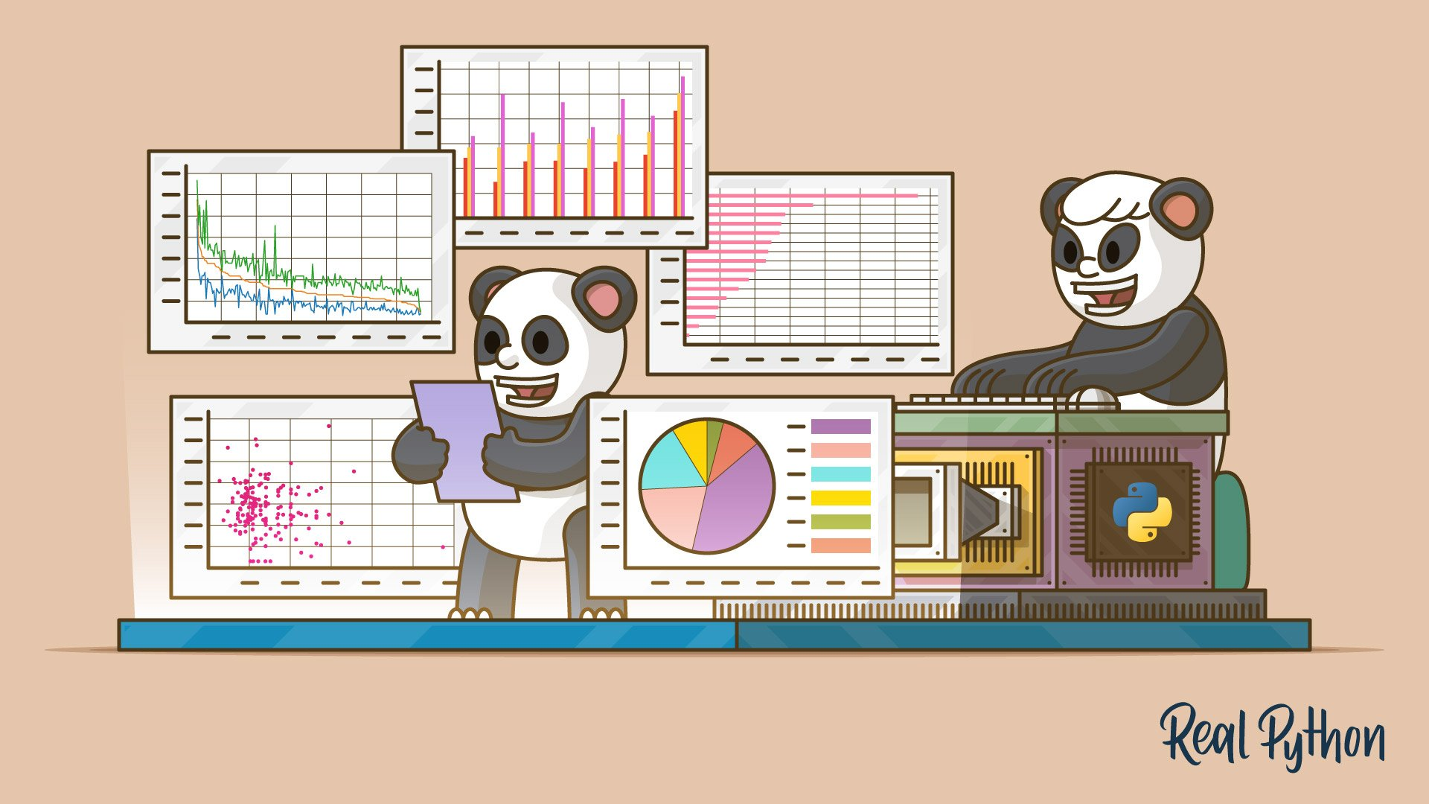
Part 1: Pandas Background
2023/24 Summer Program

Slide 8
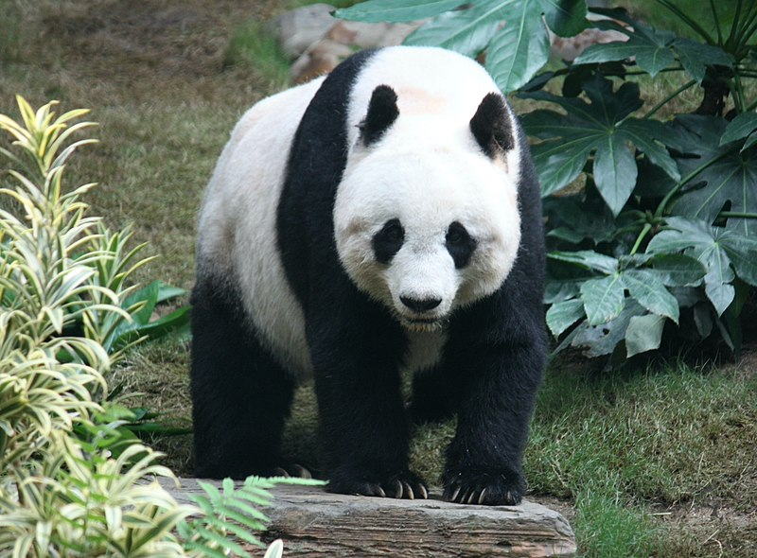
Pandas
What is Pandas?
Open-source package used for data manipulation
Integrates well with other libraries like Matplotlib
1. New data structures
DataFrame:
2-D table data structure: list-like data associated with column name
Series:
1-D labelled array that holds data of any type
2. Data manipulation
Optimized for use with large datasets
Can import, clean, reshape, subset data

Slide 9
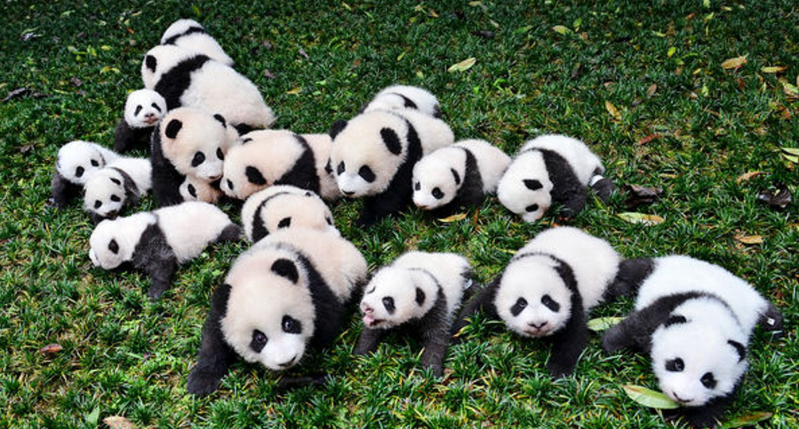
DataFrames and Series
DataFrames
1. Tabular data structure
Columns: Variables
Rows: Observations
2. Easy data access
Can be sliced across either axis
Subsetting [rows which meet given condition(s)]
Indexing (retrieve rows by index value)
3. Flexible
Dataset columns can be different types
E.g. Continuous values, categorical variables, strings, etc
Works well with modelling, statistics packages

Slide 10
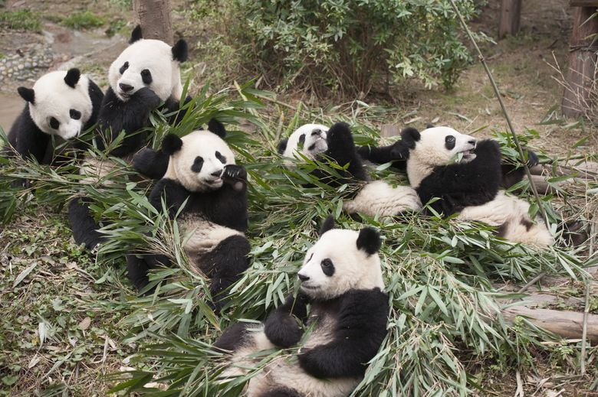
DataFrames and Series
Series
1. One-dimensional labelled array
Like list, with label
2. Access
Can be sliced, subsetted, indexed
3. Flexible
Can hold any type of data
4. Interactions with DataFrame
When grabbing one column’s values, outputted as Series
5. Built-in statistical functions
Calculate summary stats (mean, median, standard deviation, etc) directly

Slide 11
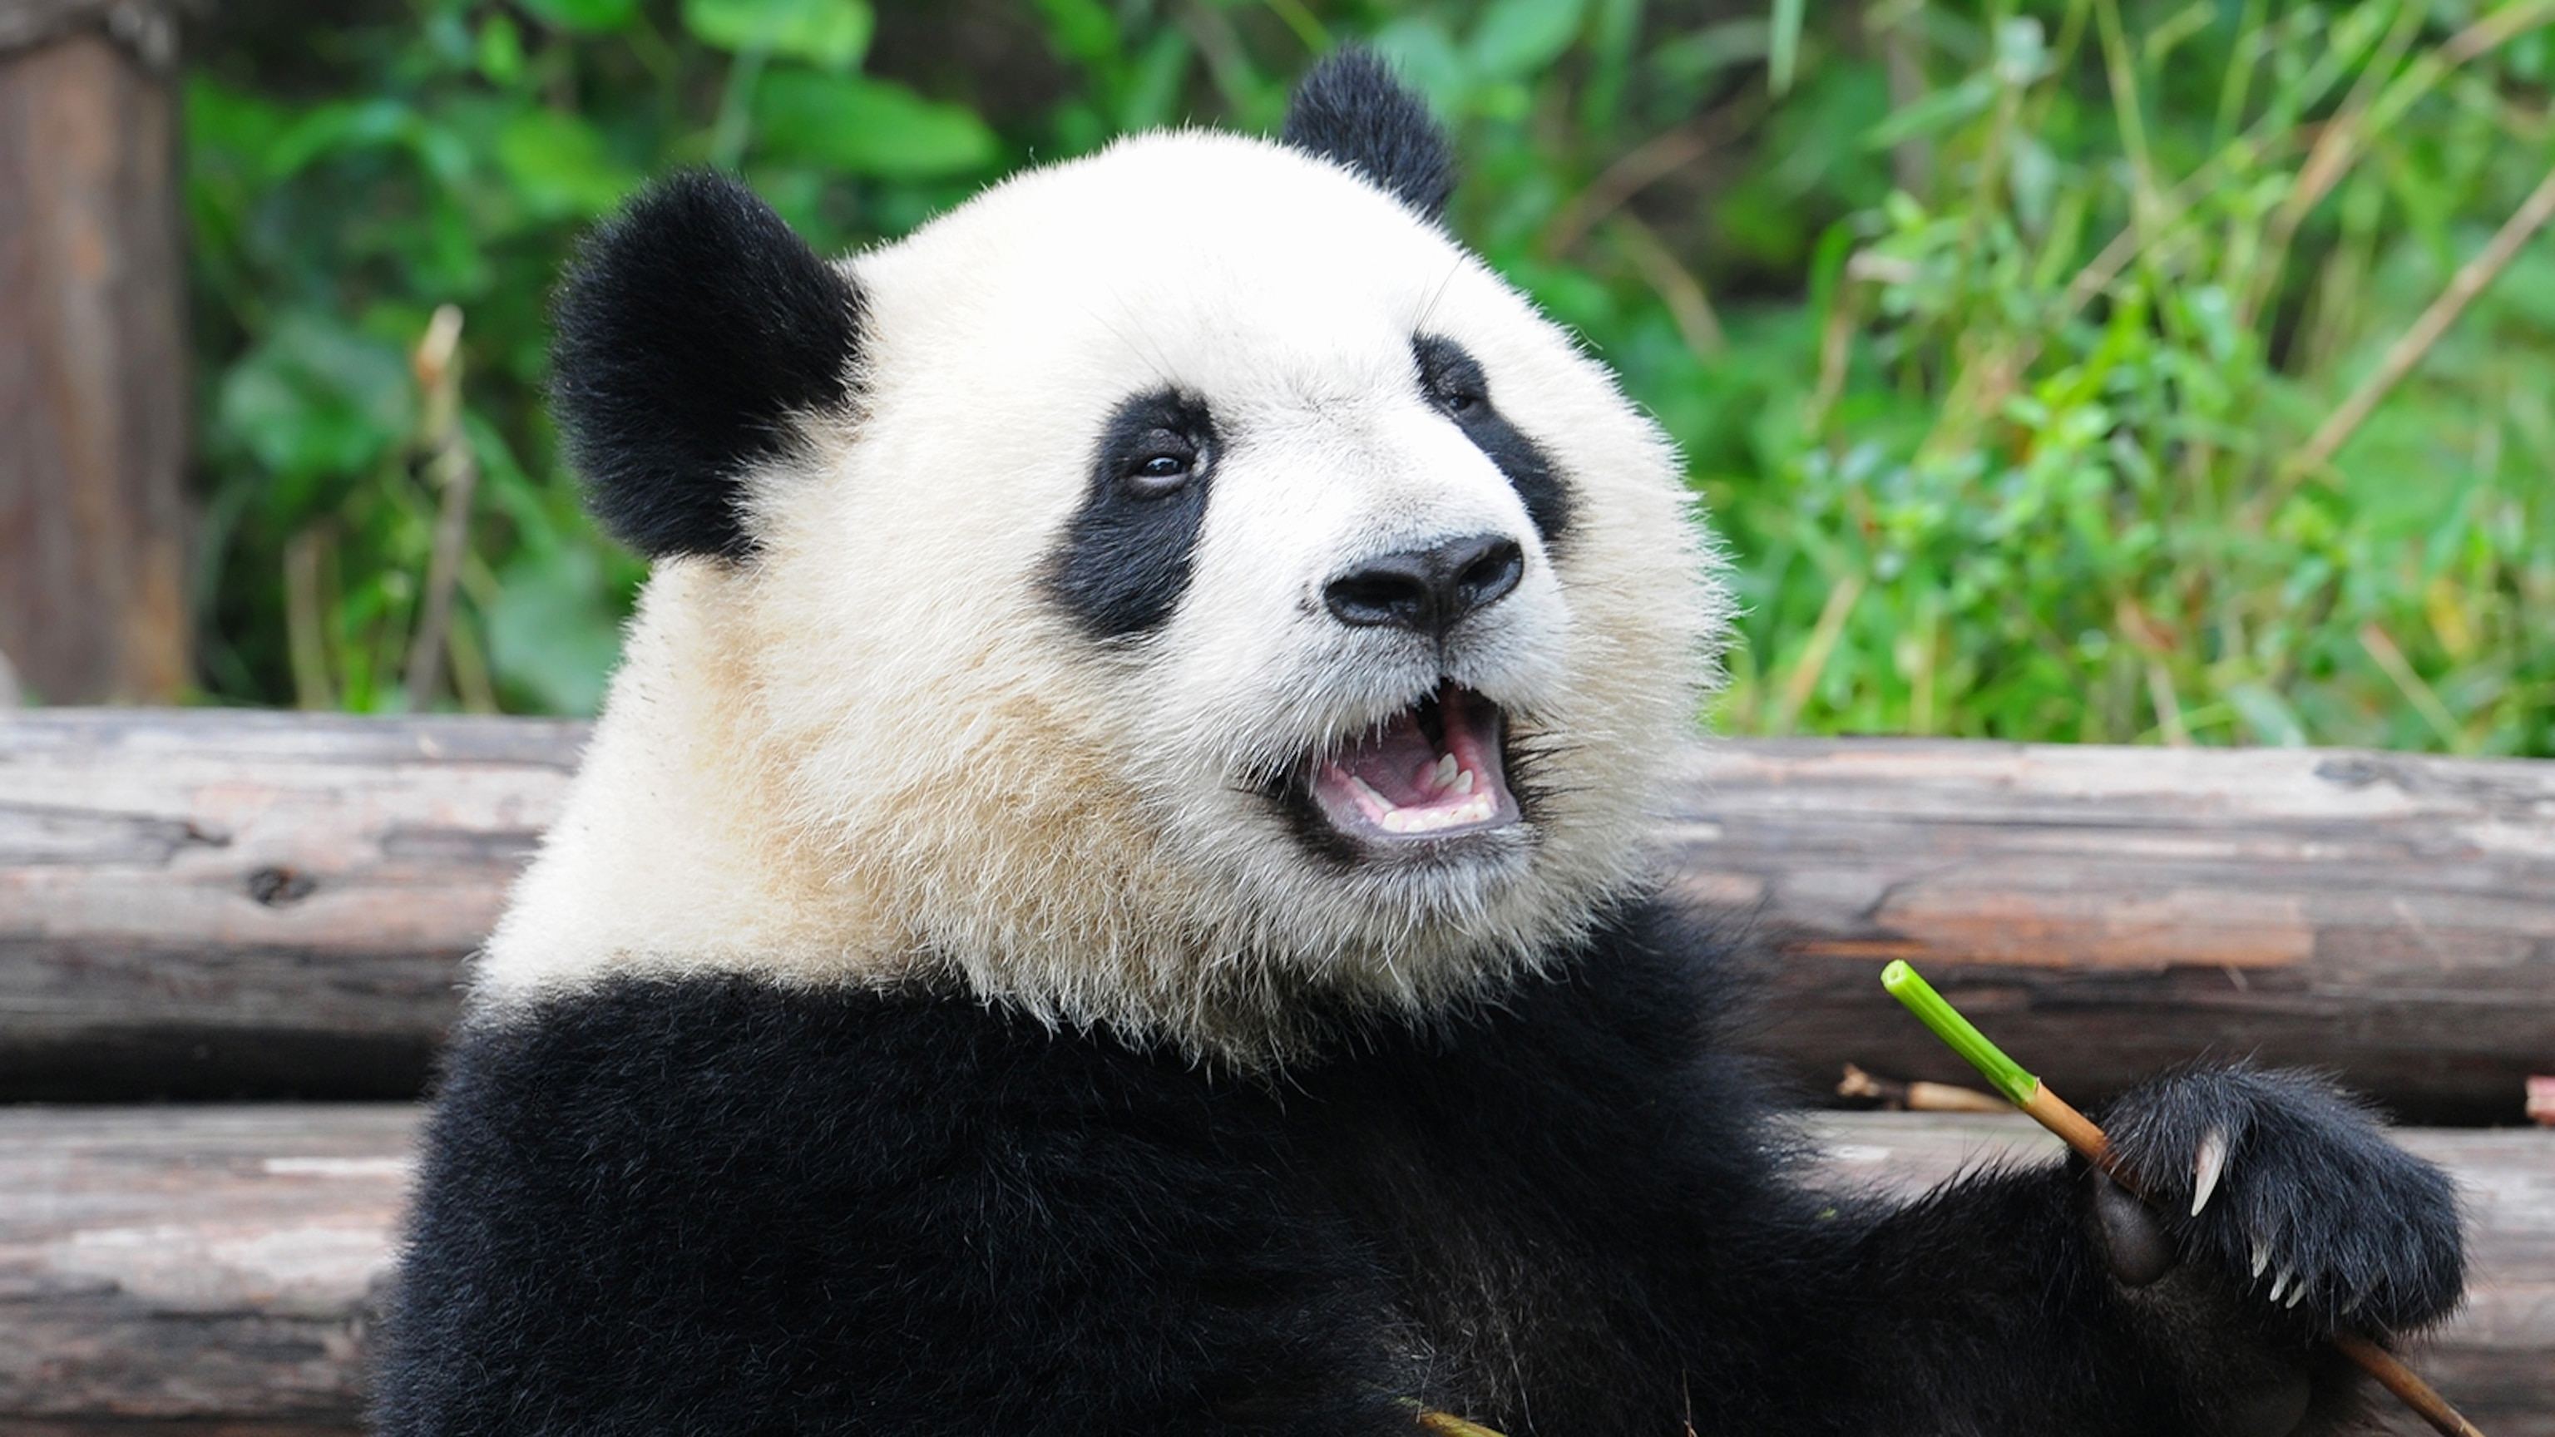
Part 2: Playing with Pandas Swapping over to Python
2023/24 Summer Program

Slide 12
Structure of Part 2
2. Pandas Exercises
2.0 Data import
pd.read_csv()
2.1 DataFrame shape
.shape
2.2 Column names, data types
.columns, .dtypes
2.3 Column summing
.sum()
2.4 DataFrame indexing
.max(), .min(), .idxmax(), .idxmin()
2.5 Slicing and selection
.loc[], .iloc[]
2.6 Boolean Filtering
df[df[“column”< value]
2.7 Column Operations
df[“new_column”] = df[“column_a”]*df[“column_b”]
2.8 Summary stats
.describe()
2.9 Capstone Exercise

Slide 13
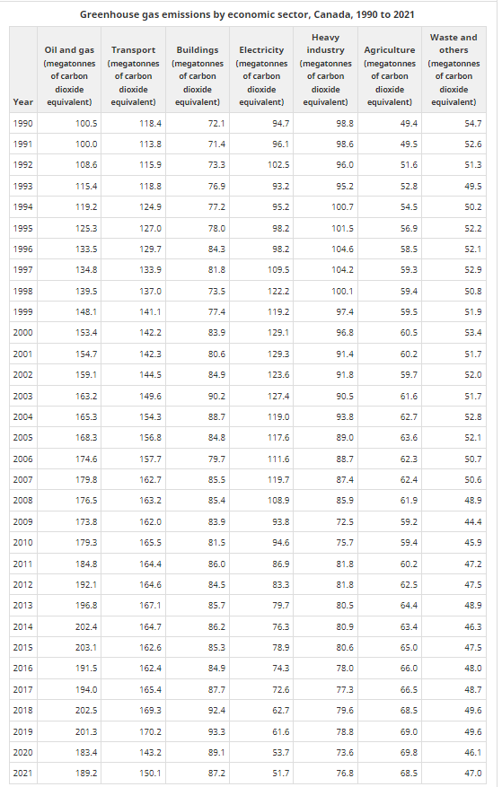
Data Introduction: Sectors
Canadian carbon emissions data, by economic sector
Posted here:
https://www.canada.ca/en/environment-climate-change/services/environmental-indicators/greenhouse-gas-emissions.html
Using both this and regional
Both measure CO2 by megaton
Sectoral spans 1990 to 2021; longer than regional

Slide 14
Python Workshop 2 Conclusion
2023/24 Summer Program

Slide 15
What we learned
What Pandas package is used for
DataFrame, Series data structures
Data import
Analyzing shape, column names, data types of DataFrame
Aggregating columns, checking values
Selection, filtering, column operations

Slide 16

Next Workshop:

Slide 17
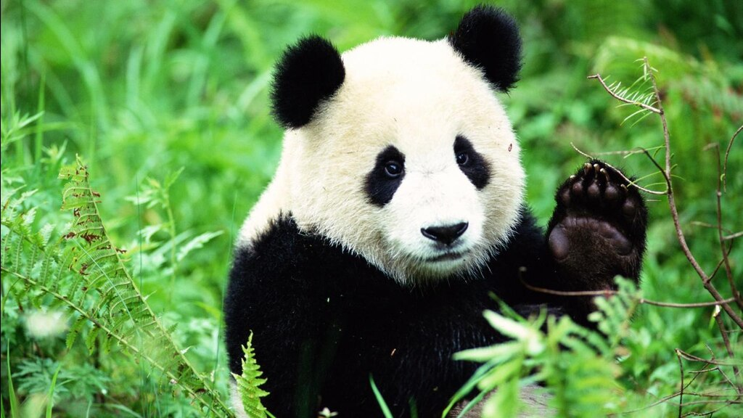
Thanks for coming!
2023/24 Summer Program

